Slide 1
Unit 203: Electrical installations technology
Electricity generation

Slide 2
Electricity generation
There are many means available to generate electricity, including the following:
coal
oil
biomass
wind
wave
hydro
nuclear
photo-voltaic
gas
micro‑generation.
https://grid.iamkate.com/

Slide 3
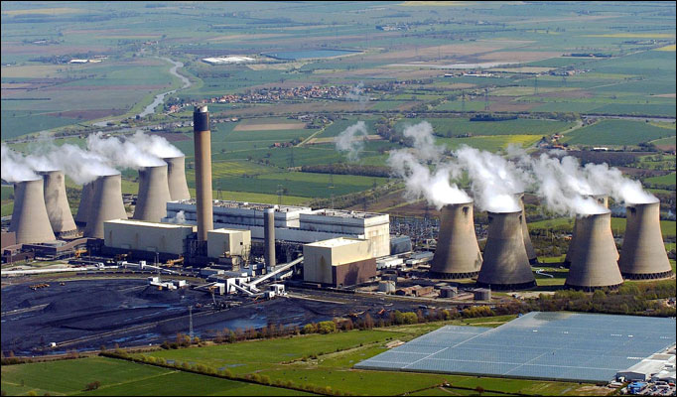
Electricity generation
Coal

Slide 4
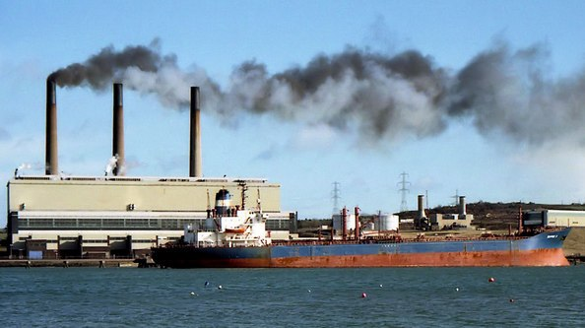
Electricity generation
Oil

Slide 5
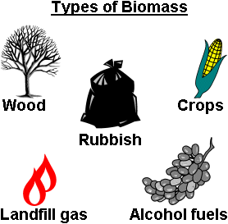
Electricity generation
Biomass

Slide 6
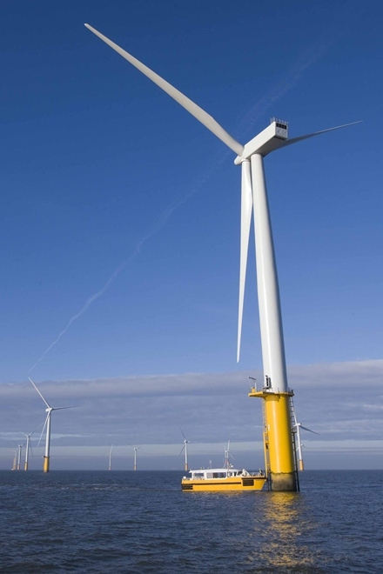
Electricity generation
Wind

Slide 7
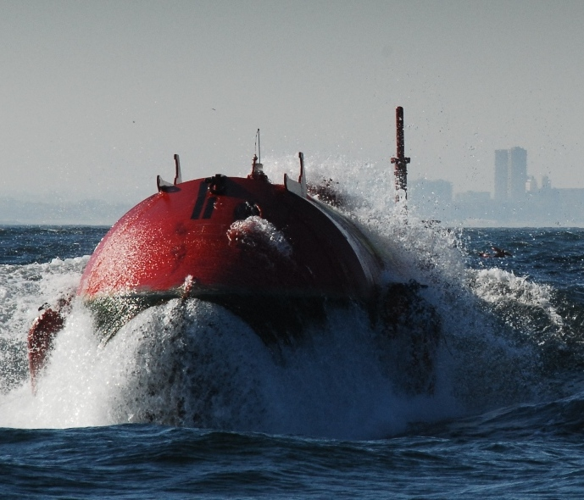
Electricity generation
Wave

Slide 8
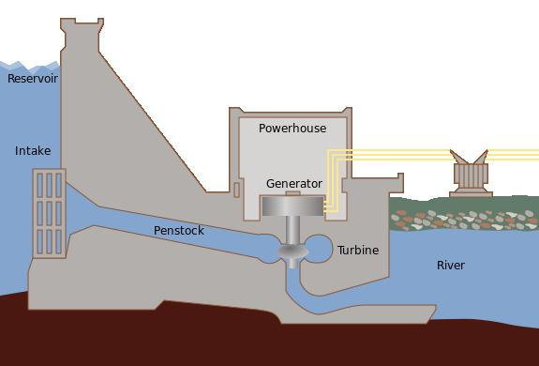
Electricity generation
Hydro

Slide 9
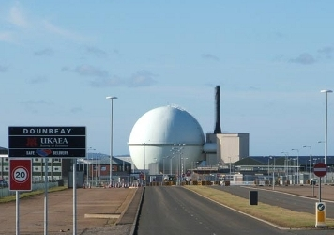
Electricity generation
Nuclear

Slide 10
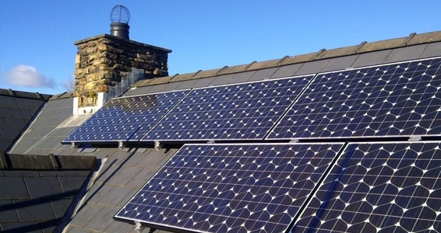
Electricity generation
Photo-voltaic

Slide 11
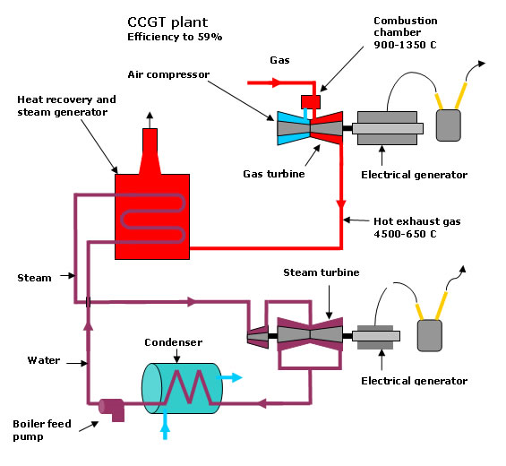
Electricity generation
Gas

Slide 12
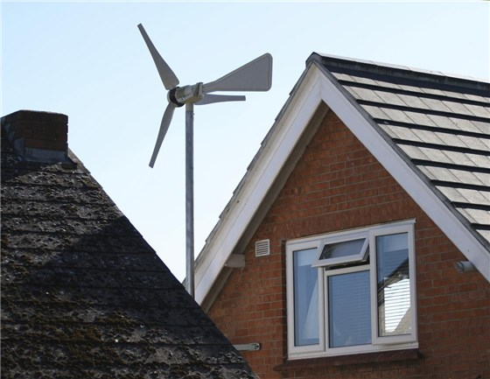
Electricity generation
Micro-generation

Slide 13
Unit 203: Electrical installations technology
The End

